Slide 1

MAP-ping Growth
KIPP ANALYTICS TEAM
DECEMBER 12, 2022

Slide 2
Basic Approach
Helpful
Definitions
This analysis examines KIPP students’ performance on NWEA’s Measures of Academic Progress (MAP) assessment.
It examines student performance by school, grade level, and special program participation.
The central finding is this: the data does not indicate a systematic problem with any KIPP school, although a particular grade and a particular special program are struggling.
“Growth”:
Growth means a student’s Spring assessment score, minus the “typical” Spring score. The “typical” Spring score is calculated by referring to the percentile of student’s Fall assessment score among MAP test-takers nationwide. The “typical” score is the Spring assessment score a student needs to remain in that same percentile.
“Goals Met”:
Categorical variable recording subjects in which students met or exceeded the “typical” score. Values can be “Both”, “Math Only”, “Reading Only”, or “Neither.”

Slide 3
Insight 1:
KIPP’S STUDENTS MISS GROWTH TARGETS

Slide 4
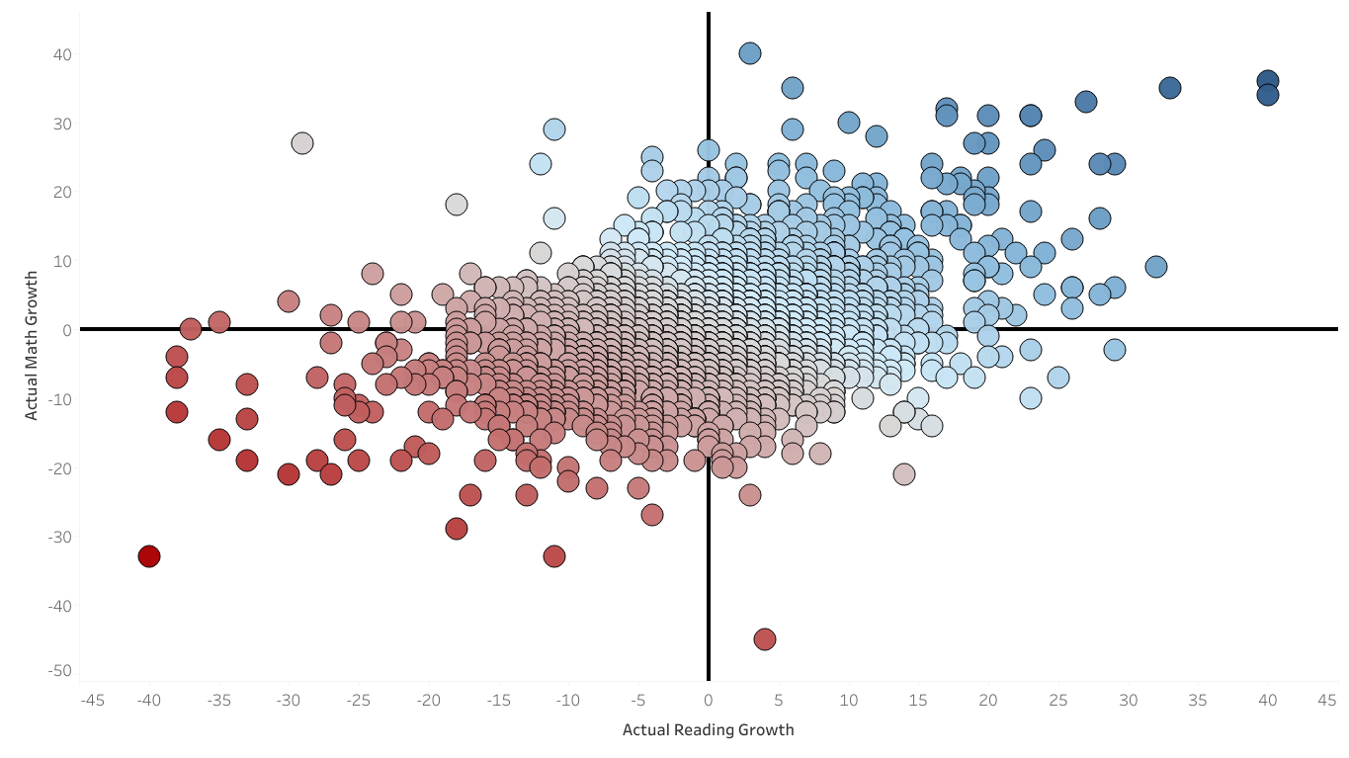
Overall Growth
Average Reading Growth:
-0.18
Average Math Growth:
-0.28

Slide 5
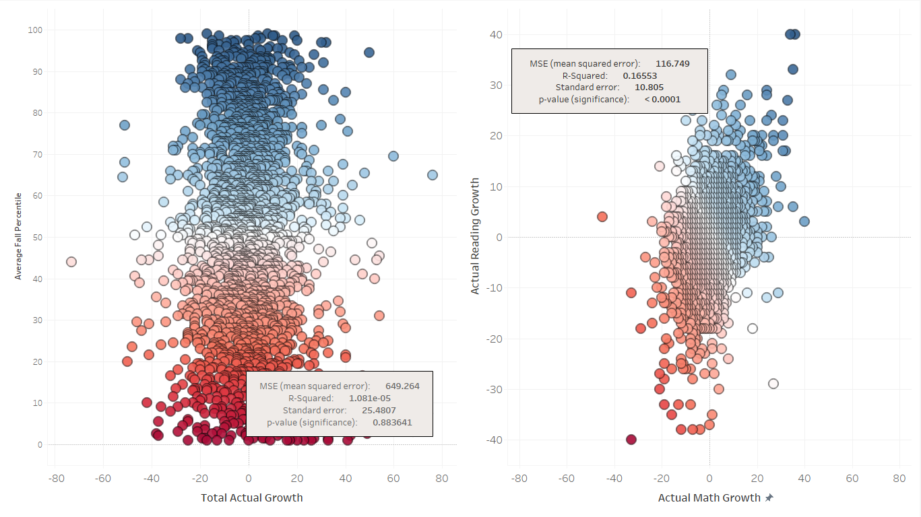
Even Though Our Students Score Slightly Above National Average …
… And Only A Small Connection Between Reading Growth and Math Growth
.. There Is No Connection Between High Scores and Growing …

Slide 6
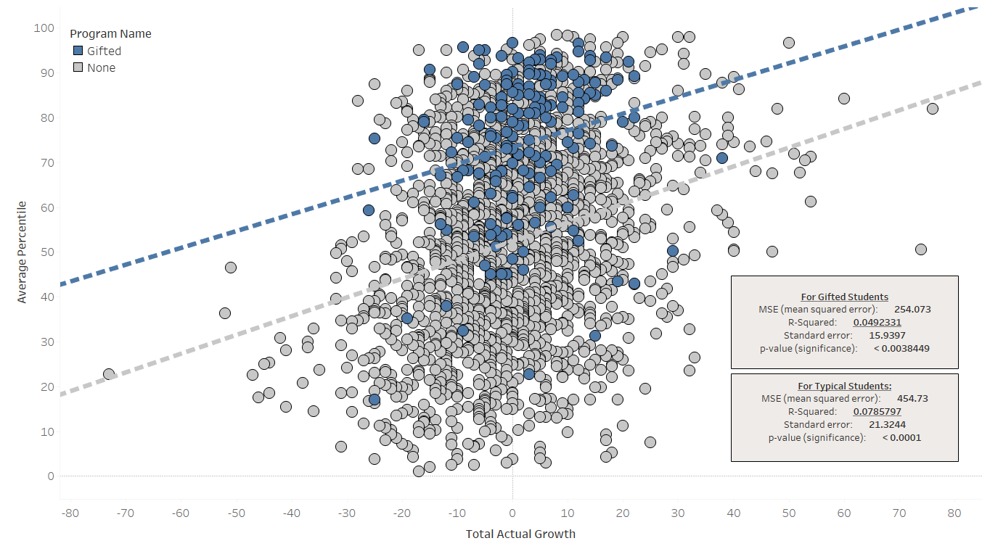
Even gifted students don’t reliably grow above expectations

Slide 7
Insight 2:
SECOND GRADE NEEDS ADDITIONAL SUPPORT

Slide 8
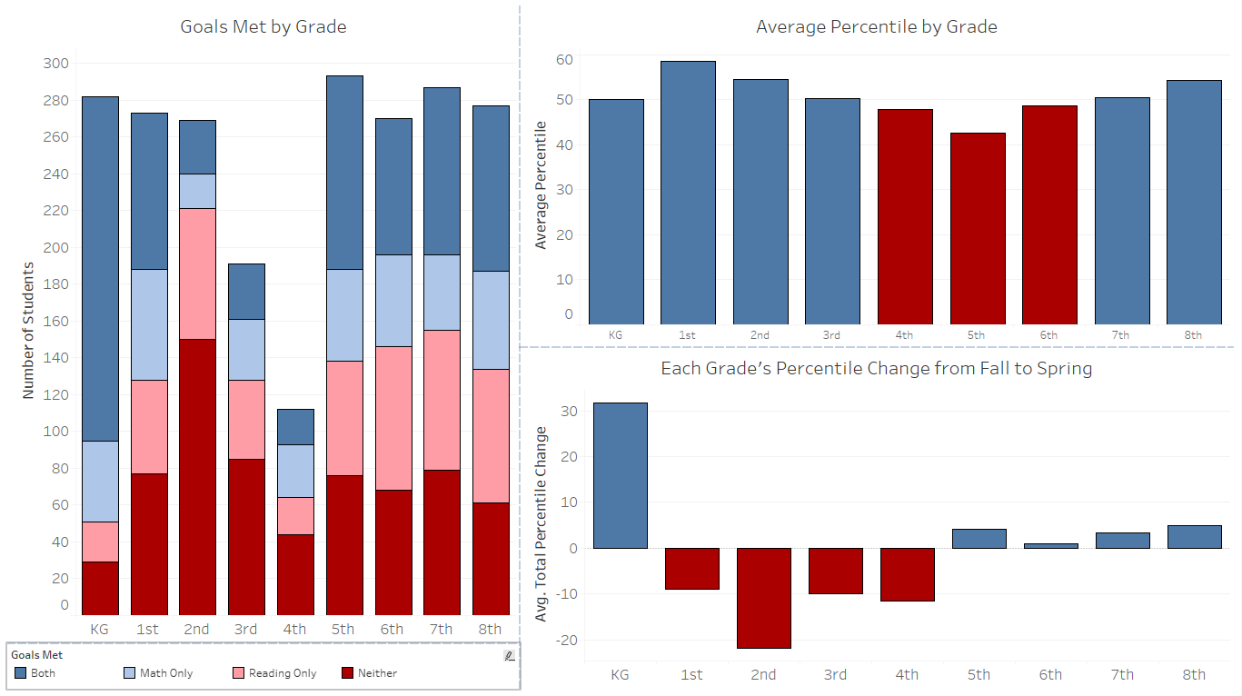
“Average Percentile” is the average of a student’s percentile rankings across both Fall and Spring assessments
Grade
Overview
Despite having an overall above-average performance, Second Grade significantly underperformed its Spring expectations
The vast majority of Second-Graders failed to meet one or both growth targets

Slide 9
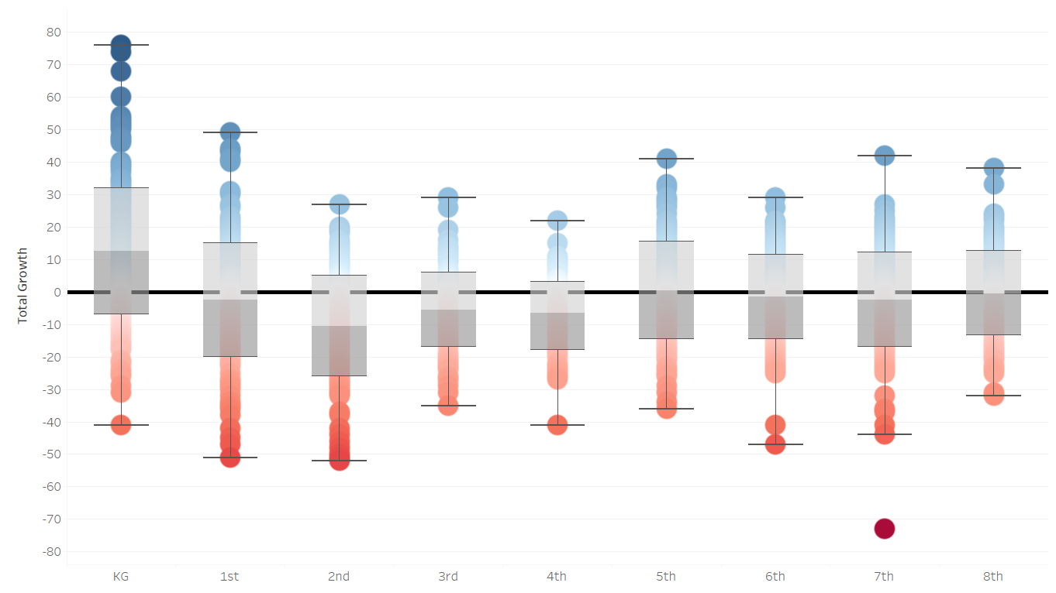
Growth by Grade
As noted, Second Grade struggled to meet expectations
However, Kindergarten showed significant growth
Growth by Grade

Slide 10
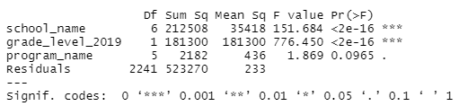
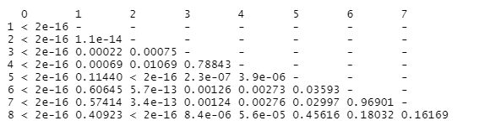
ANOVA Results
This number indicates the growth data from the grades is not the result of randomness
Significance testing strongly suggests that the problems experienced by the Second Grade are not the result of random variance
Small values = low probability that findings are the result of randomness
These numbers indicate that Second Grade’s results are likely not the product of randomness

Slide 11
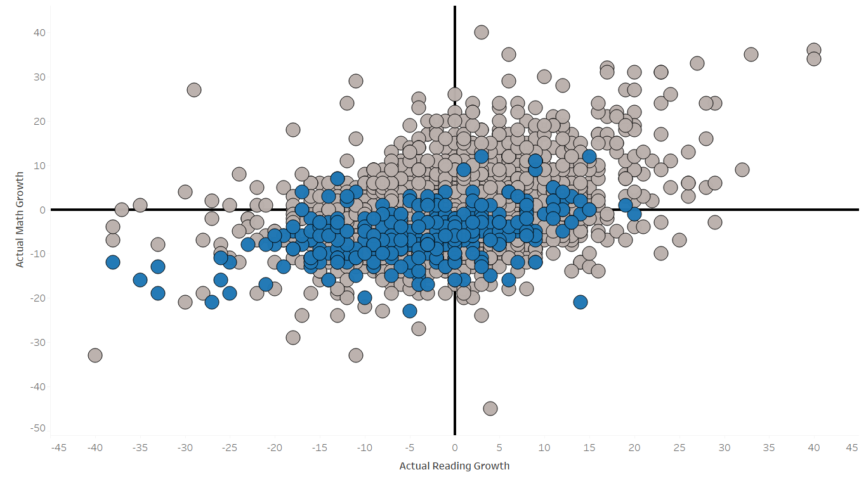
Second Grade Average Reading Growth:
-3.9
Second Grade Average Math Growth:
-5.7
This quadrant is struggling to grow in both subjects – Second Graders are shown in blue

Slide 12
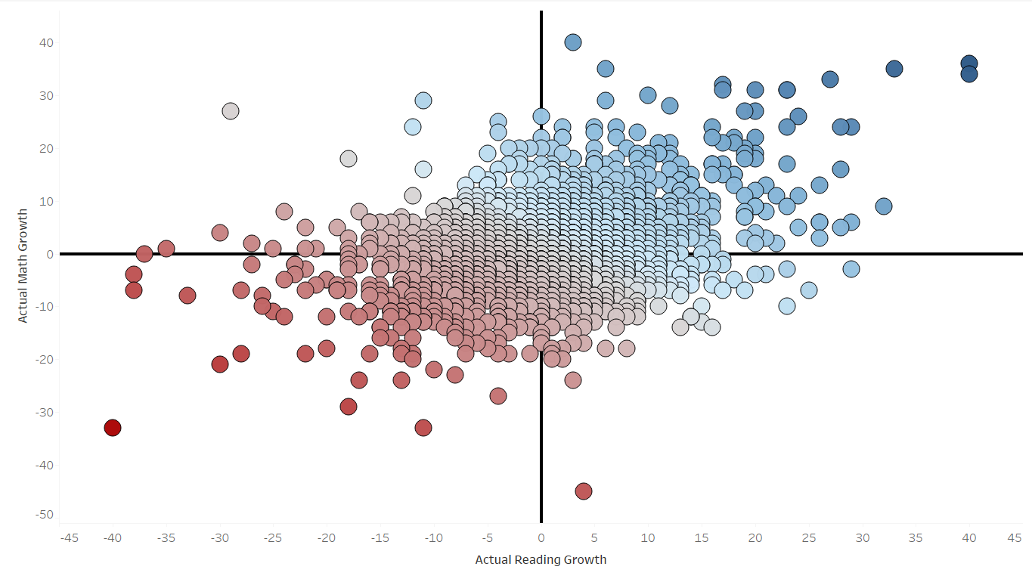
If Second Grade’s scores are left out of the accounting, KIPP exceeds growth targets
Average Reading Growth Without Second Grade :
0.33
Average Math Growth Without Second Grade :
0.45

Slide 13
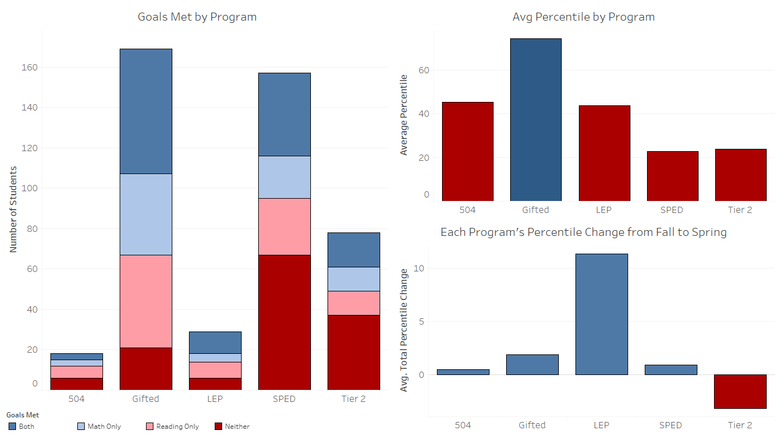
Second Grade’s difficulties are not explained by a higher-than-normal population of students that need special support from dedicated programs
The LEP program showed really strong growth from Fall to Spring
Tier 2 struggled to hit growth targets
Program
Overview

Slide 14
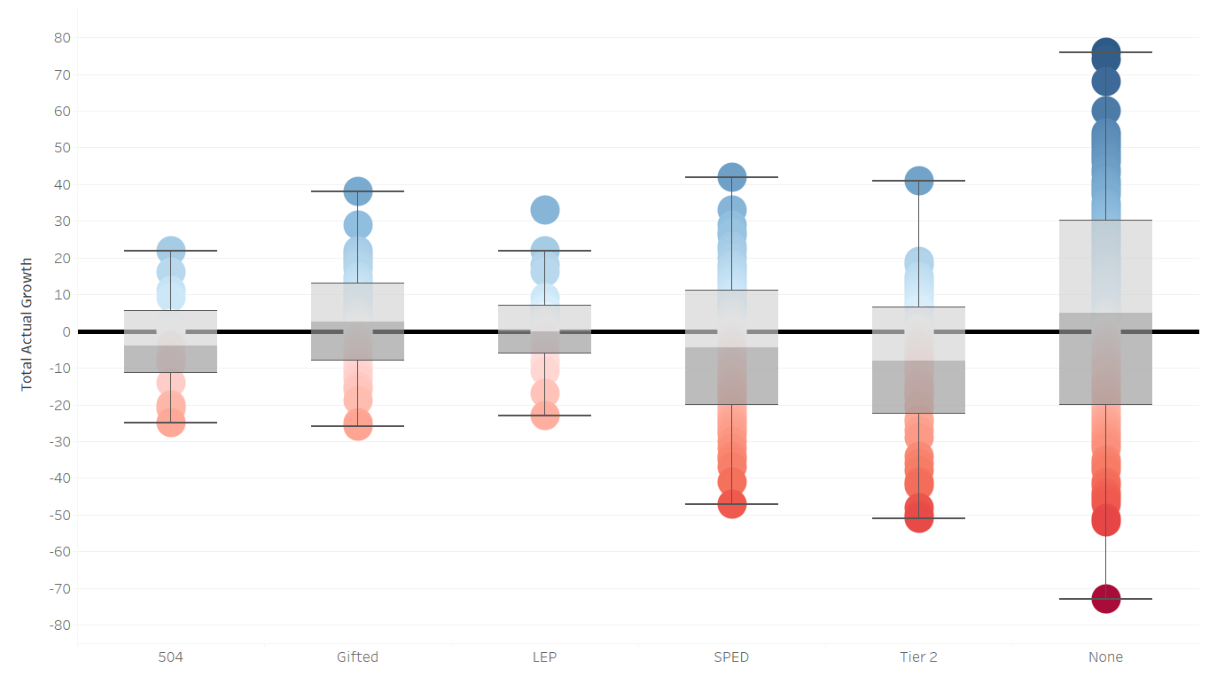
Growth by Program
Lower Whisker: -23
Lowest Among All Categories
No special program’s lowest quartile of students grew less than students who only took general education courses

Slide 15
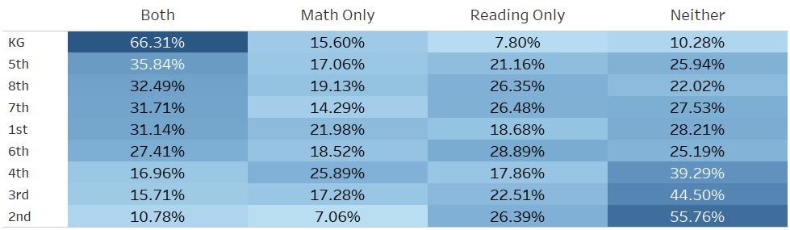
Second grade also has the highest rate of missing both math and reading targets
Second Grade’s rate of meeting both growth targets is the lowest among all grades

Slide 16
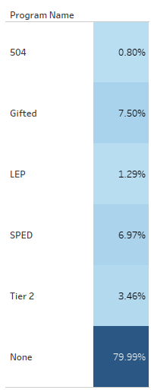
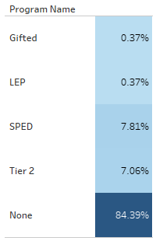
Second Grade does contain a higher-than-average percentage of students from a struggling program
Second Grade also contains only a handful of Gifted Students
All Grades
vs
Second Grade
However – even if Second Grade’s Tier 2 scores are excluded, their Average Reading Growth is -3.7, and their Average Math Growth is -5.6
This is only a < 0.5 change from Second Grade’s performance counting all its students

Slide 17
Insight 3:
SCHOOL E NEEDS ADDITIONAL SUPPORT

Slide 18
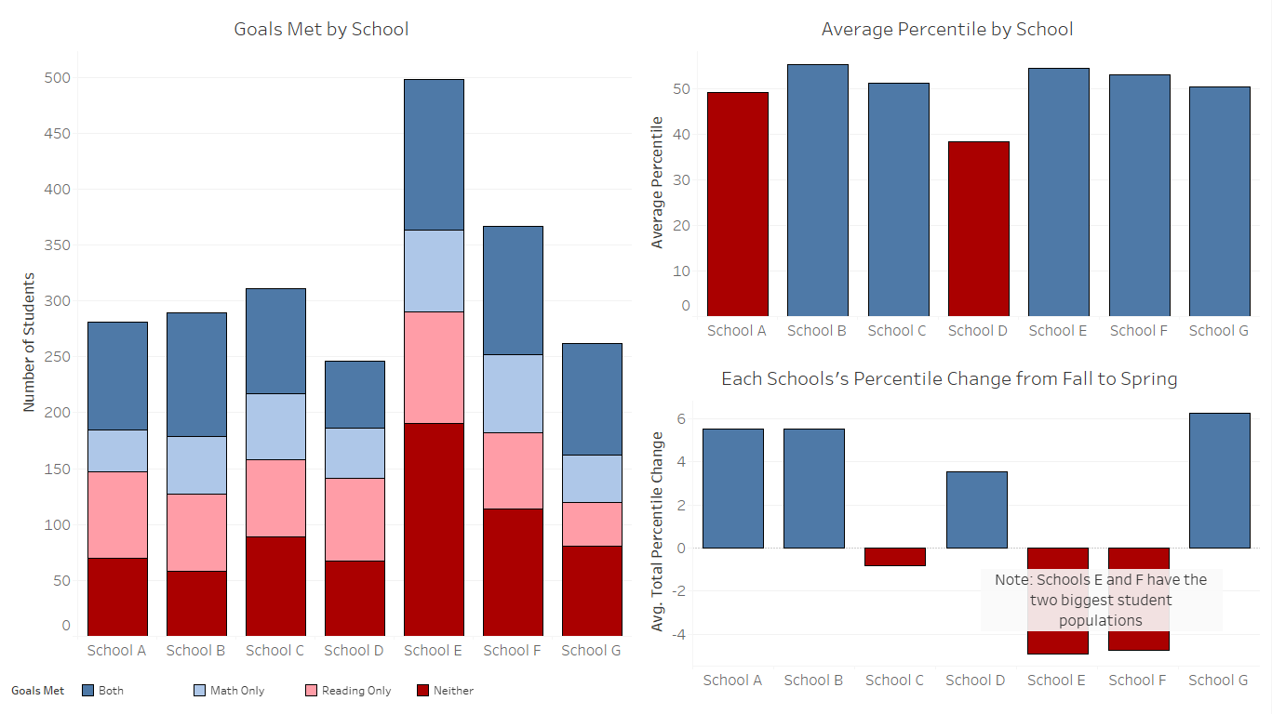
School
Overview
Many School E students underperformed expectations
As with the Second Grade, this underperformance occurs despite on overall above-average scores

Slide 19
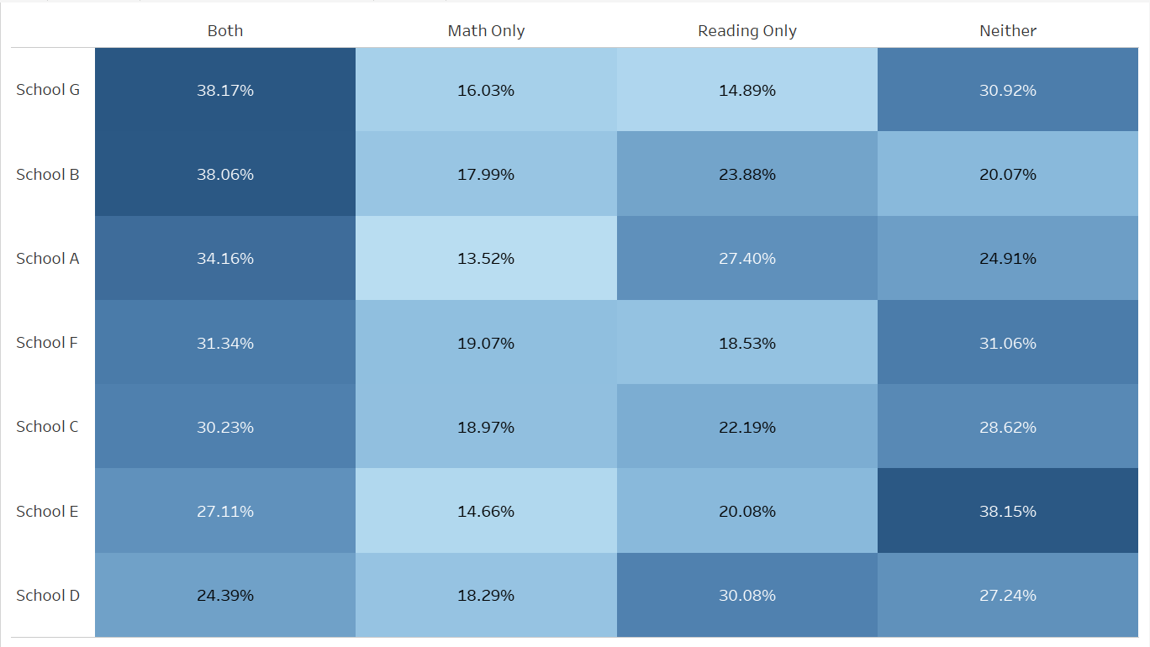
School E’s underperformance isn’t a merely a result of having more students. Their rate of meeting both growth targets is the second lowest among all schools
School E also has the highest rate of missing both math and reading targets

Slide 20
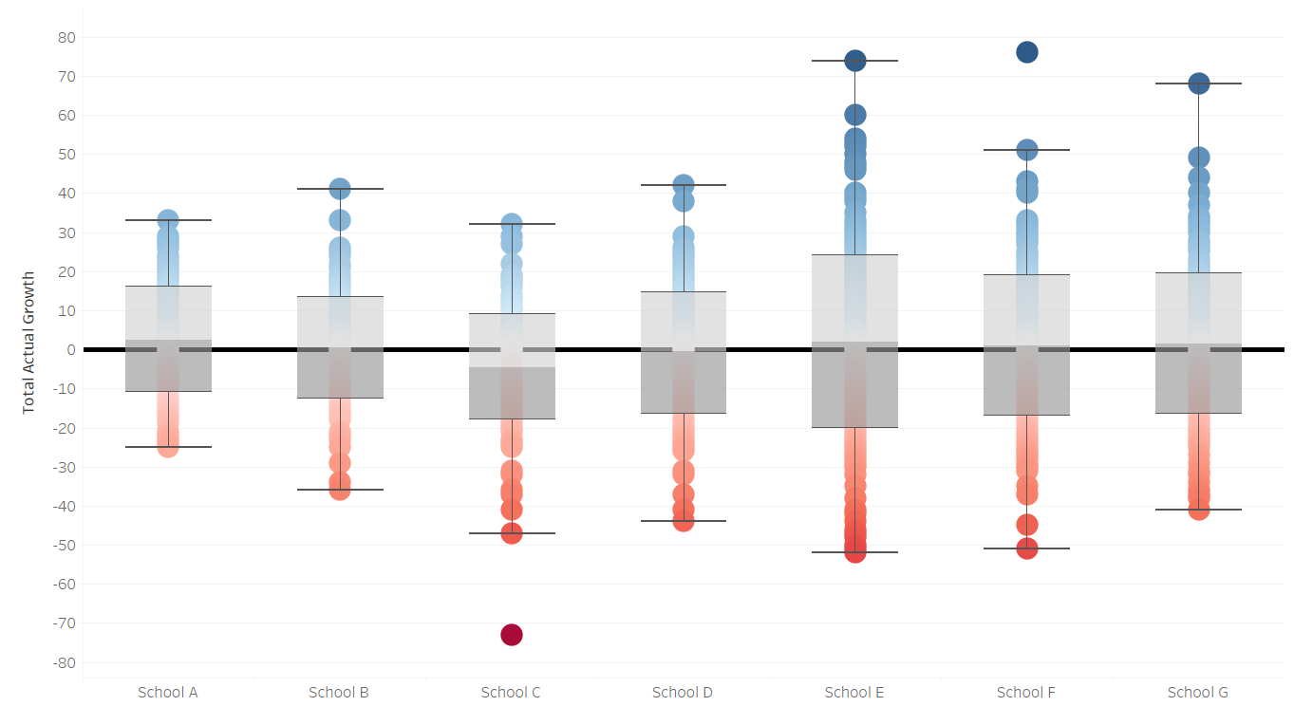
Growth by School
Median: 2
Despite poor success rates, School E’s median growth is above 0 – signaling that most School E students met or exceeded expectations
However, School E’s underperformers struggled more than their counterparts in other schools
Lower Whisker: -52

Slide 21
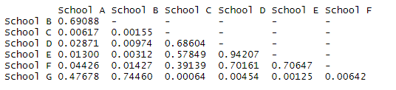
ANOVA Results
This number indicates the growth data from the schools is not the result of randomness
Significance testing strongly suggests that the problems experienced by School E are not the result of random variance
Small values = Small probability that findings are the result of randomness
These numbers indicates that School E’s results are not the result of randomness

Slide 22
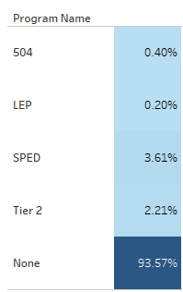
School E’s lack of growth can’t be explained by an oversaturation of Tier 2 students
All Schools
vs
School E

Slide 23
Appendix
For detailed information regarding the processing and cleaning of the data used in this presentation, please consult the R markdown file included with this presentation.
As a general overview, I prepared the data for this presentation by joining the tables with information about student performance to tables that recorded each student’s grade level and special program participation. Students with incomplete records were not included in this analysis.

